Slide 1
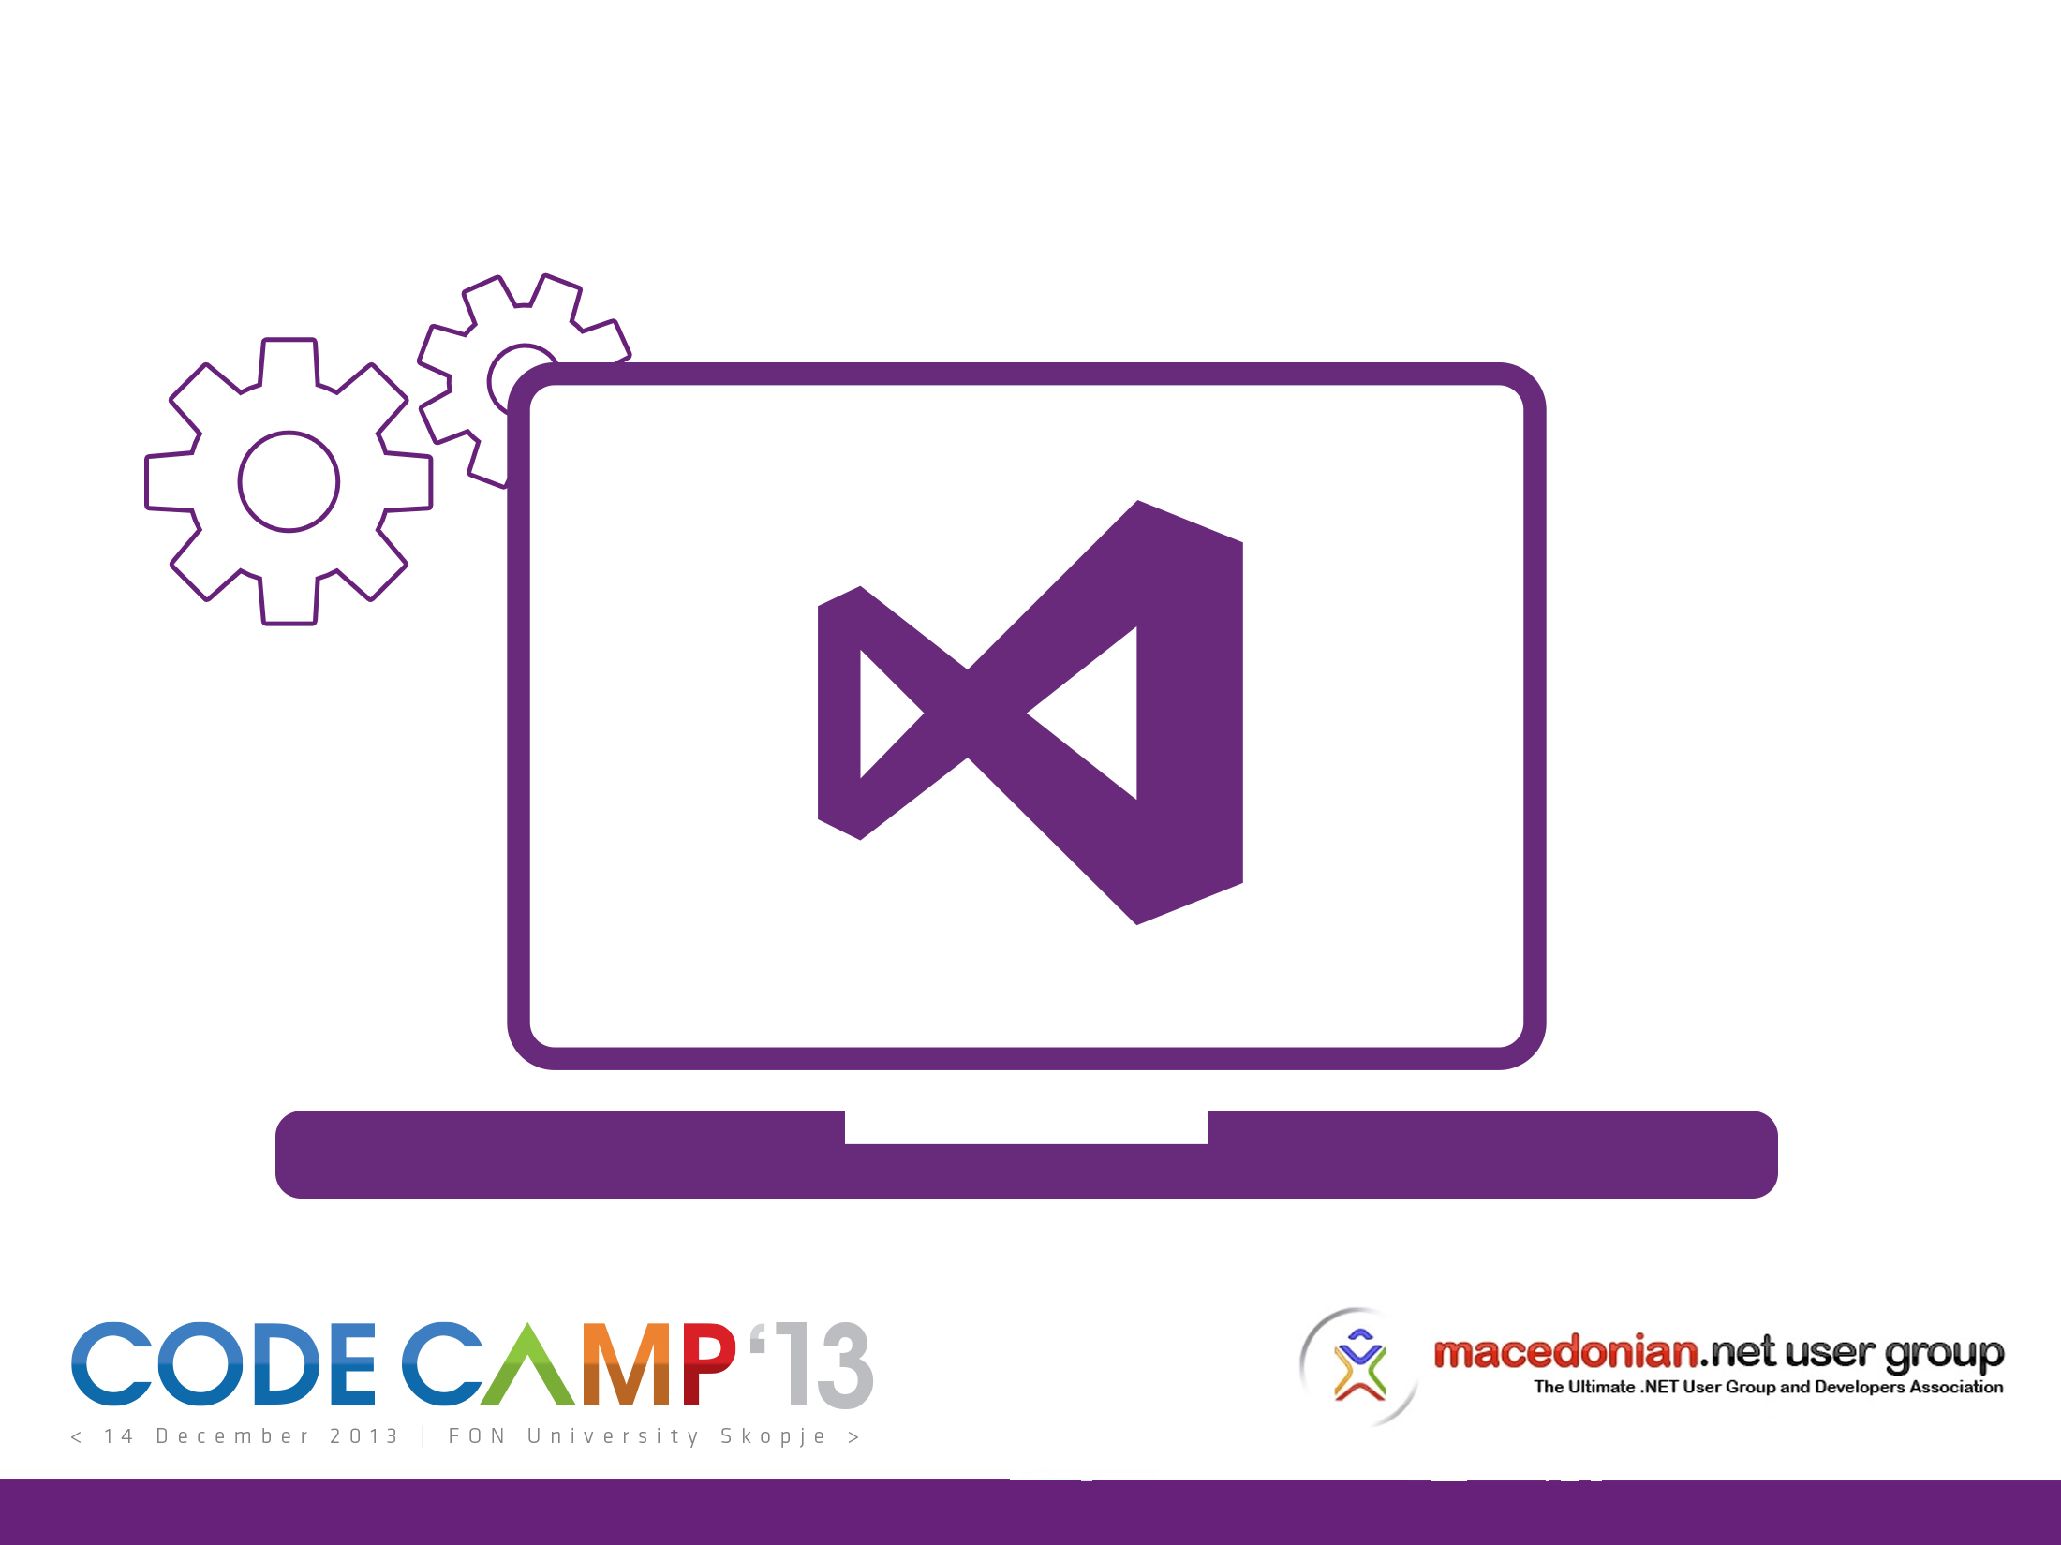

Slide 2
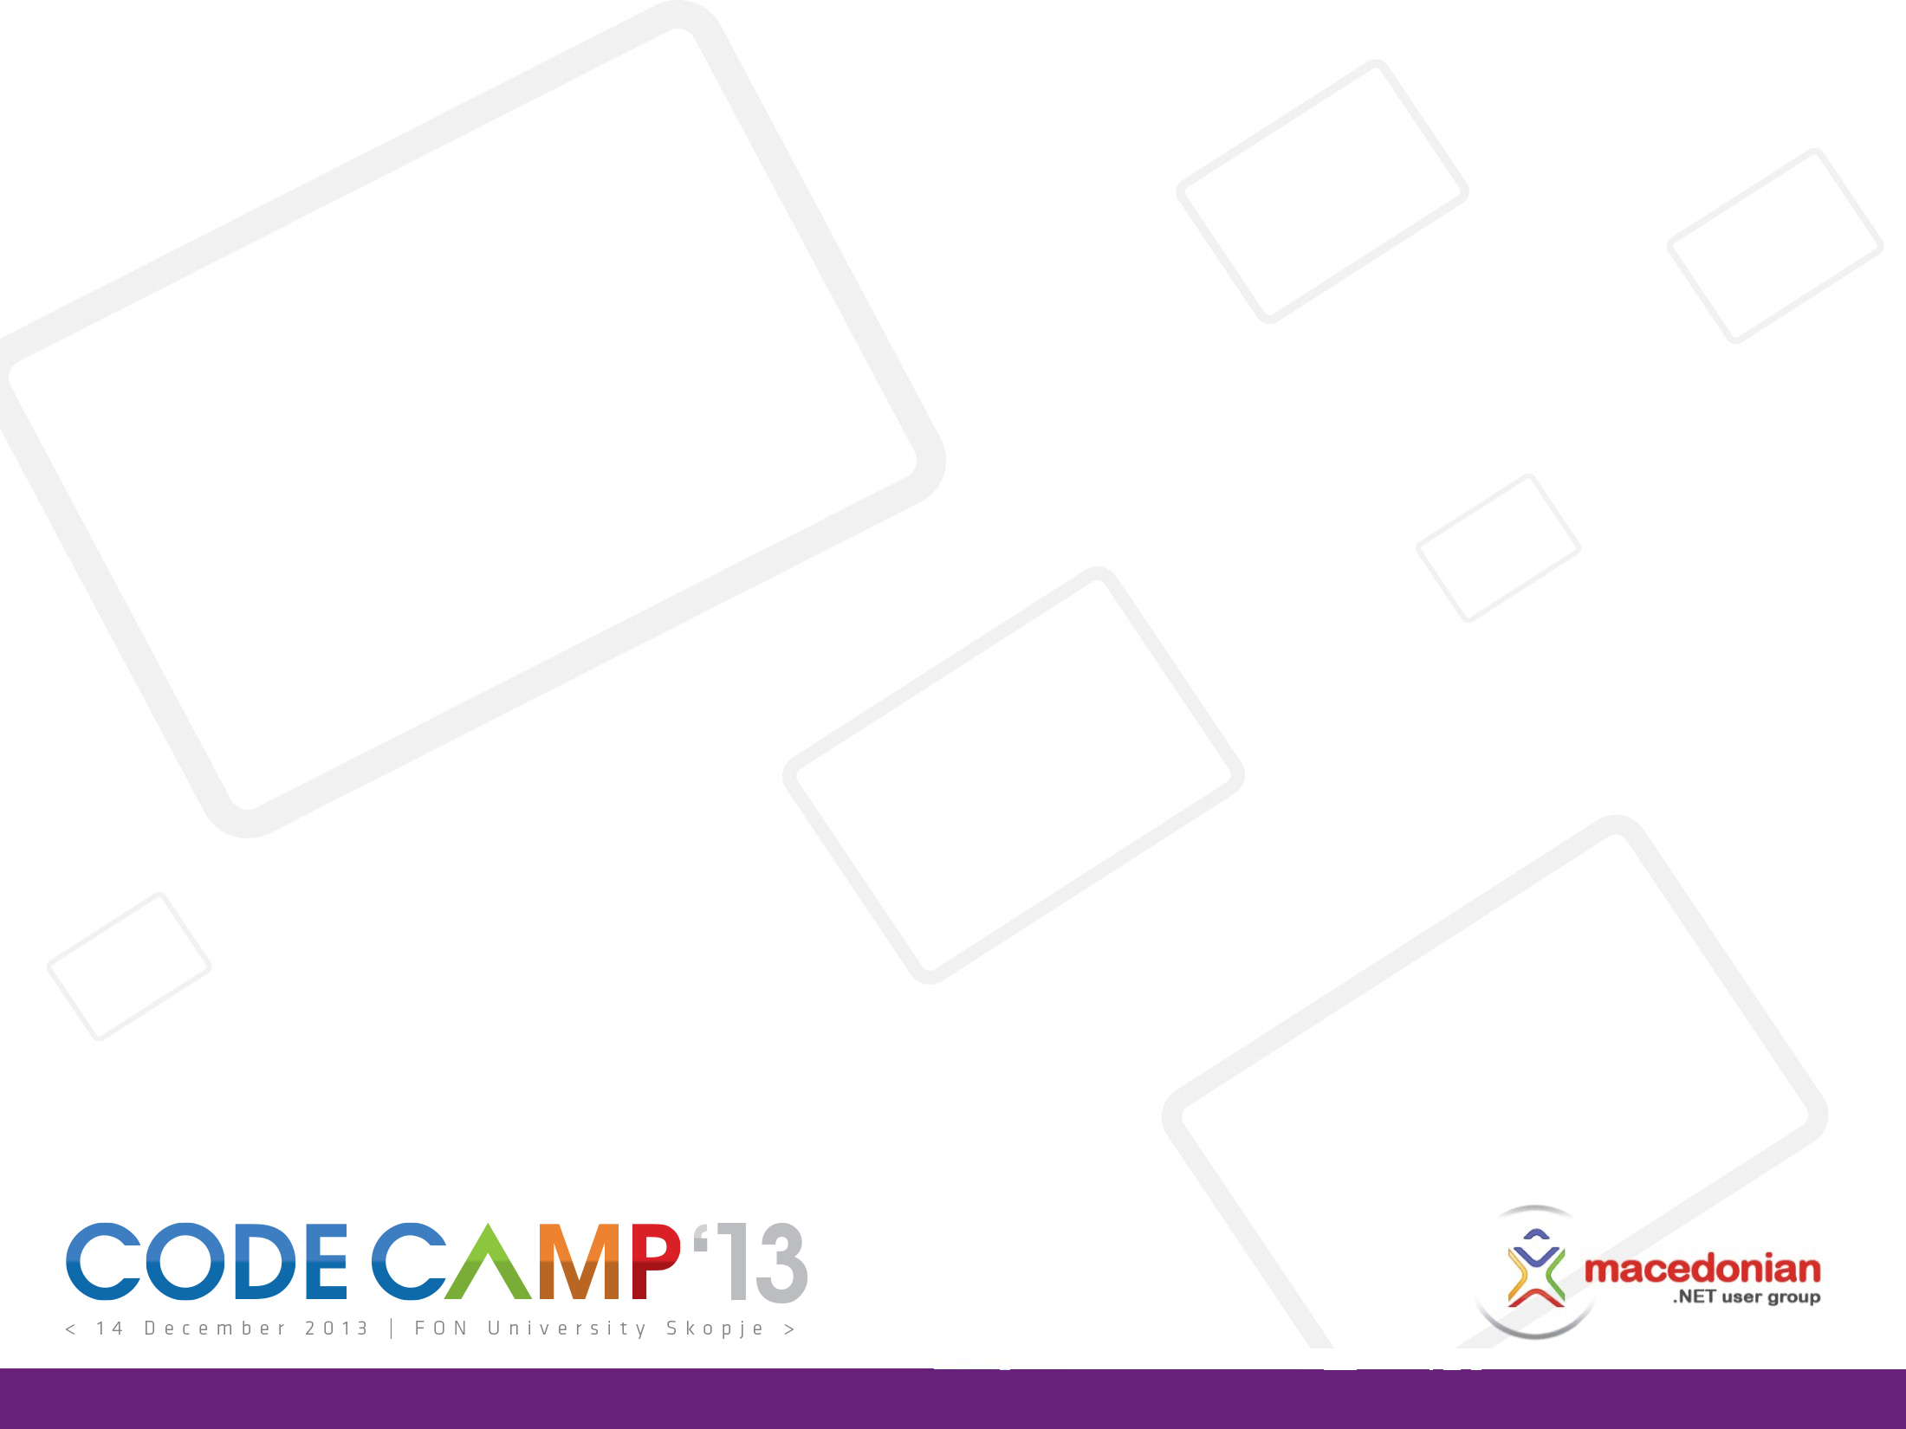


Angular JS + NancyFx + MongoDB = Ultimate Trio For Building SPA apps
@bojanv91
Bojan Veljanovski, Software Engineer &
Lead Technology Researcher, HASELT

Slide 3


Slide 4
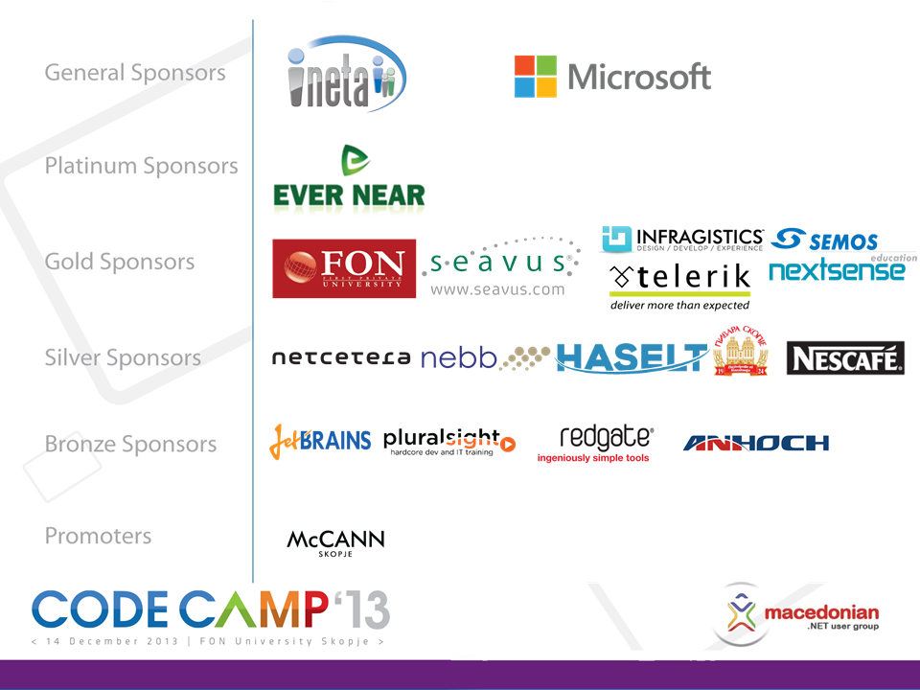

Slide 5
Bojan Veljanovski
@bojanv91
Software Engineer and Lead Technology Researcher, HASELT
Microsoft Certified Professional
Technical Speaker
Ex - Microsoft Student Partner
Co-Founding member, Leader & Speaker of FINKI Tech Club

Slide 6
“It's not longer good enough to build web apps around full page loads and then progressively enhance them to behave more dynamically .” - Throne of JS Conference, 2012

Slide 7
Traditional Web App
Server
Browser
Page HTML
Web Page
Navigate
Page HTML
Web Page

Slide 8







Next-Gen Web The web is moving to the client

Slide 9



What’s in the session?
What is Single Page Application
and why it matters
Basic concepts for successful SPA
and tools for building it
How to build complete end-to-end SPA in few steps
e.g. Let’s c0de!

Slide 10
What is SPA?
Rich and responsive web application
All HTML/CSS/JS are loaded onto one page
New content is pulled via AJAX
UI interactions are handled in the browser
Examples:
GitHub, Gmail, Azure Management Portal

Slide 11
Characteristics of good SPAs
Based on HTML, CSS and JavaScript
Does NOT break the browser
Fast and responsive
Should feel like native application
Reduces server overhead

Slide 12
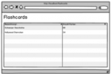
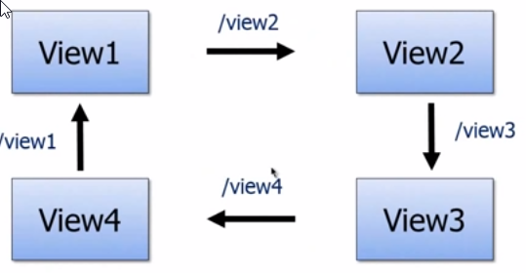
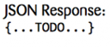

How SPA works
Web UI
HTML/CSS/JS
Page Load (index.html)
REST Services
JSON / XML
Server
Client

Slide 13
Common SPA features
MVC - based
Data-binding (2-way)
Declarative programming
Routing
Encourages modularization

Slide 14
Frameworks & Libraries

Slide 15



Slide 16
Angular.js
Very light framework
Large community
Great documentation
Encourages good design patterns
Ideal for CRUD apps

Slide 17
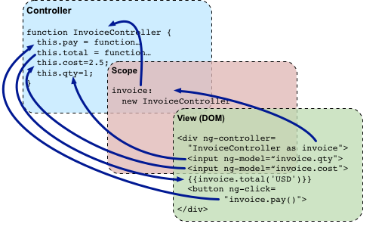
Angular.js 101
Notes:
Views, Models, Controllers, $scope the glue between them

Slide 18
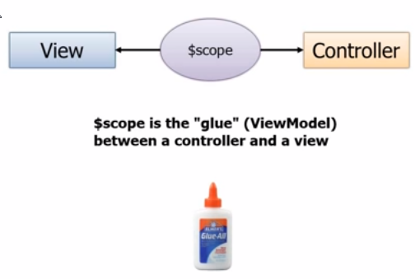
Angular.js 102

Slide 19
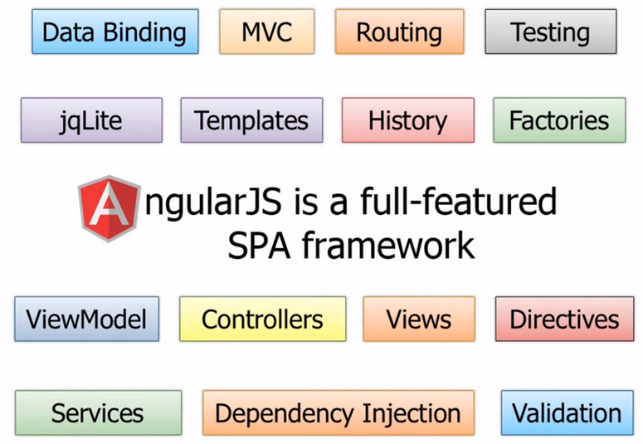
Angular.js – Full Stack

Slide 20
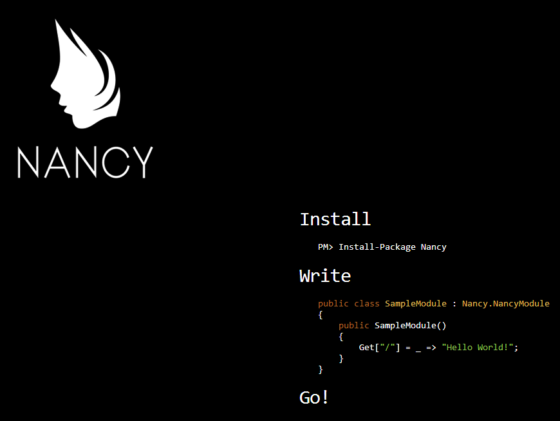

Slide 21
Nancy (Back-end)
Lightweight framework for building HTTP services
Open Source C#/.NET/Mono
Inspired by Sinatra from Ruby world
You can write Hello World Nancy app into a single tweet (DEMO!)
Notes:
Inspired by Sinatra (Ruby DSL for building web apps)
The goal is to stay away as much as possible and provide-super-duper happy path to all interactions
public class Module : NancyModule { public Module() { Get["/greet/{name}"] = x => { return string.Concat("Hello ", x.name); }; } }

Slide 22

MongoDB (Storage)
NoSQL
Open-source
Document-oriented storage
JSON-style documents
Scalable
LINQ support with C# driver

Slide 23
Let’s C0DE

Slide 24
Outcomes from the SPA approach
Front-end becomes almost Native
Back-end becomes just Clean and Thin API
Storage becomes natural for the Web (JSON)

Slide 25
Use cases when to go to SPA…
Highly interactive web apps
Data intensive web apps
Mobile web apps
With offline support (cache manifest, local storage)
Apps meant to be used for long continuous period

Slide 26
…but careful, SPA roads are bumpy
Code duplication on client and server can occur
Secure your APIs
SPA stacks depend on many 3-rd party libraries, beware of compatibility issues
Step learning curve
Strong JavaScript skills are required

Slide 27
Questions?
Complete electronic evaluation forms on the computers in the hall and enter to win!
Telerik Ultimate Collection
CodeSmith Tools Generator Pro Personal
JetBrains ReSharper
Seavus EDC training vouchers
Pluralsight subscriptions
and many more…

Slide 28
